Slide 1

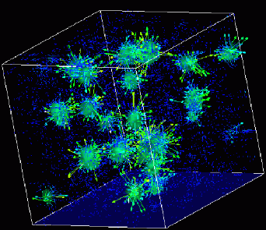

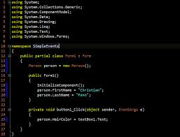
Advanced
Scientific Computing
(SciComp 201)
Session 15
Random Processes

Slide 2
Session Goals
Consider stochastic (random) processes and identify various laws governing their underlying statistics
Assembling straws of varying length
Comparing birthdays among a group of people
Dealing a deck of cards
Encode and decode two independent concepts into a single integer using the / and % (modulus) operators
Continue to instrument code to gauge runtime performance and measure the impact of algorithm optimization efforts

Slide 3

Lab 1 – Random Straws
Write a program to perform a million runs of an experiment that places a varying number of straws end-to-end each run
In each run, start with a single straw of random length between 0 ≤ n < 1
Then enter a loop that keeps adding additional straws of random length (0 ≤ n < 1) until the total length is > 1
Find the mean number of straws added before the total length exceeds 1, across all million runs of the experiment

Slide 4
Lab 1 – Random Straws
0.63
1.0
0.89
Straws
0.13
0.89
0.63
1
0.13
0.45
2
0.13
0.76
Run # 1
3
1.21
1
0.13
Run # 2
2
1.02
0.13
0.76
1
0.13
0.07
0.25
2
0.13
0.20
Run # 3
0.07
3
0.13
0.25
0.45
0.07
4
1.21

Slide 5
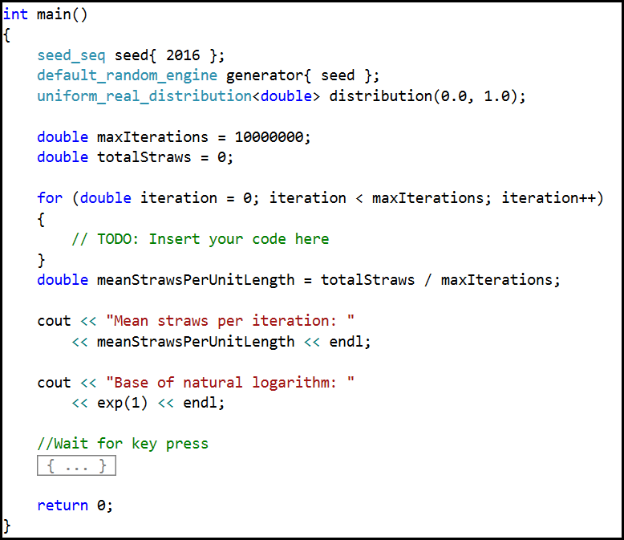
Lab 1 – Random Straws

Slide 6
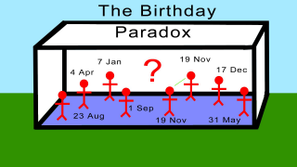
Lab 2 - Birthday Paradox
Given a class size of n students, write a program to calculate the probability that at least two students in the class share the same birthday
Your code should calculate this probability for all class sizes between 2 and 80 students inclusive
Assume there is only 365 days in a year (no leap years)
What is the minimum required class size to have > 50% probability of two similar birthdays?

Slide 7
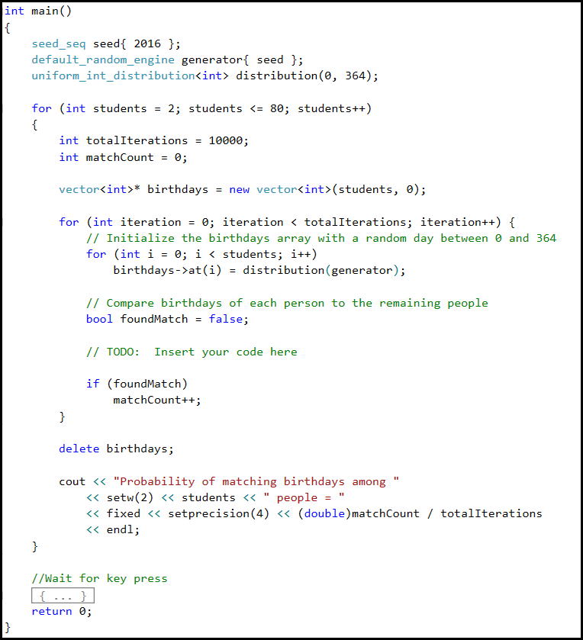
Lab 2 Birthday Paradox

Slide 8
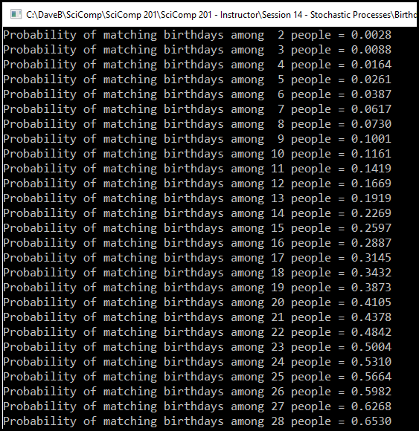
Lab 2 – Birthday Paradox

Slide 9
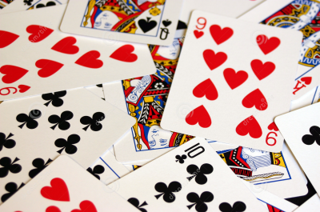
Encoding (Representation)
Cards in a deck are numbered 0 – 51
Card Suit |  |  | Card Rank
0 | Clubs |  | 0 | Deuce
1 | Diamonds |  | 1 | Three
2 | Hearts |  | 2 | Four
3 | Spades |  | 3 | Five
 |  |  | 4 | Six
 |  |  | 5 | Seven
 |  |  | 6 | Eight
 |  |  | 7 | Nine
 |  |  | 8 | Ten
 |  |  | 9 | Jack
 |  |  | 10 | Queen
 |  |  | 11 | King
 |  |  | 12 | Ace
How can we convert to & from a card # and a specific suit and rank?

Slide 10
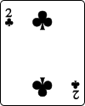

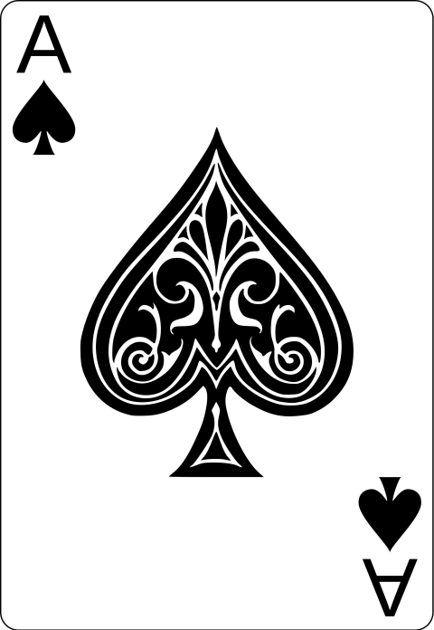
Encoding (Representation)
Cards in a deck are numbered 0 – 51
Card # = Suit * 13 + Rank
Card Suit |  |  | Card Rank
0 | Clubs |  | 0 | Deuce
1 | Diamonds |  | 1 | Three
2 | Hearts |  | 2 | Four
3 | Spades |  | 3 | Five
 |  |  | 4 | Six
 |  |  | 5 | Seven
 |  |  | 6 | Eight
 |  |  | 7 | Nine
 |  |  | 8 | Ten
 |  |  | 9 | Jack
 |  |  | 10 | Queen
 |  |  | 11 | King
 |  |  | 12 | Ace
Suit = 0
Rank = 0
0 * 13 + 0 = 0
Suit = 2
Rank = 10
2 * 13 + 10 = 36
Suit = 3
Rank = 12
3 * 13 + 12 = 51

Slide 11
Decoding (Representation)
Cards in a deck are numbered 0 – 51
Suit = (Card #) / 13
Rank = (Card #) % 13
Card Suit |  |  | Card Rank
0 | Clubs |  | 0 | Deuce
1 | Diamonds |  | 1 | Three
2 | Hearts |  | 2 | Four
3 | Spades |  | 3 | Five
 |  |  | 4 | Six
 |  |  | 5 | Seven
 |  |  | 6 | Eight
 |  |  | 7 | Nine
 |  |  | 8 | Ten
 |  |  | 9 | Jack
 |  |  | 10 | Queen
 |  |  | 11 | King
 |  |  | 12 | Ace
With integers,
/ returns a whole number
39 / 7 = 5
% is the modulus (remainder)
39 % 7 = 4

Slide 12


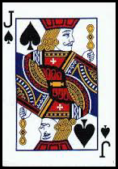
Decoding (Representation)
Cards in a deck are numbered 0 – 51
Suit = (Card #) / 13
Rank = (Card #) % 13
Card Suit |  |  | Card Rank
0 | Clubs |  | 0 | Deuce
1 | Diamonds |  | 1 | Three
2 | Hearts |  | 2 | Four
3 | Spades |  | 3 | Five
 |  |  | 4 | Six
 |  |  | 5 | Seven
 |  |  | 6 | Eight
 |  |  | 7 | Nine
 |  |  | 8 | Ten
 |  |  | 9 | Jack
 |  |  | 10 | Queen
 |  |  | 11 | King
 |  |  | 12 | Ace
Card # = 11
Suit = 11 / 13 = 0
Rank = 11 % 13 = 11
Card # = 29
Suit = 29 / 13 = 2
Rank = 29 % 13 = 3
Card # = 48
Suit = 48 / 13 = 3
Rank = 48 % 13 = 9

Slide 13
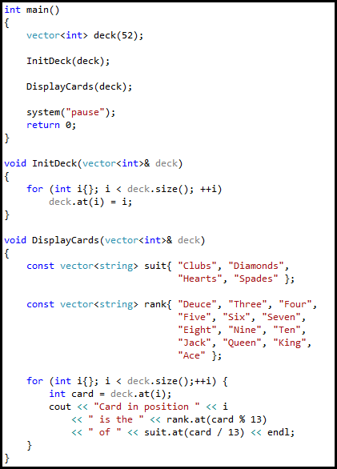
Lab 3 – List Cards
Write a program to display on screen the rank and suit of all 52 cards in an sorted deck
Suits should be shown in order, first by Clubs (low), then Diamonds, then Hearts, then Spades (high)
Ranks within each suit should be ordered Deuce (low) to Ace (high)

Slide 14
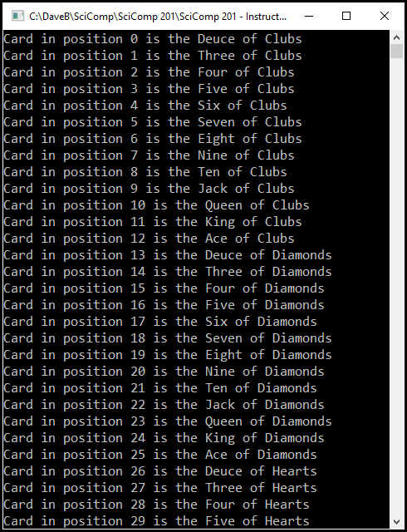
Lab 3 List Cards

Slide 15
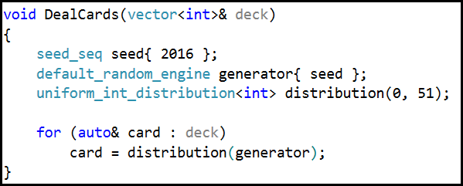
Lab 4 – Bogus Card Dealer
Write a program to randomly deal and display a deck of cards
In each element in the “deck” vector, store a random number between 0 and 51 to represent a card #
No coding required – just run the solution

Slide 16
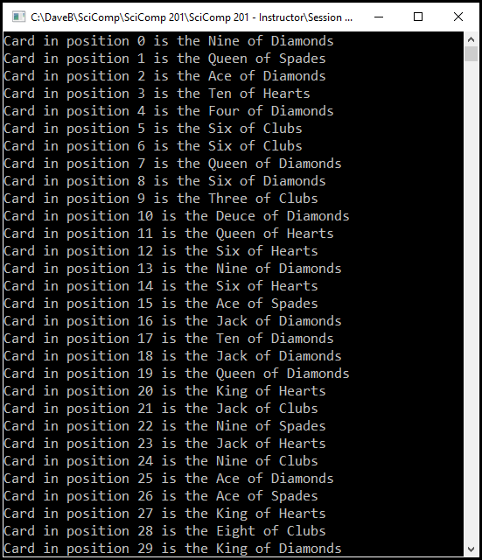
Lab 4 Bogus Card Dealer

Slide 17
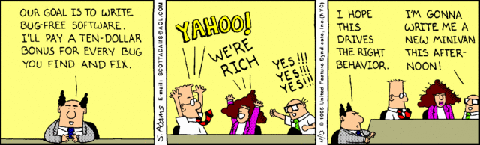
Lab 4 – Bogus Card Dealer
How can we get a set of random numbers where no number is repeated until all numbers are picked at least once?
Can we flag that a particular card # has already been dealt, and therefore not deal that card again?

Slide 18
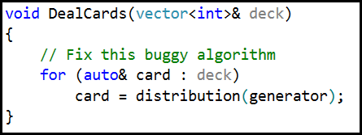
Lab 5 – Slow Card Dealer
Write a program to correctly deal 10,000 decks of cards
Rewrite DealCards() so it never deals the same card twice
Use clock() to measure the total elapsed time spent running the deal algorithm

Slide 19

Lab 5 Slow Card Dealer 3,824 ms

Slide 20
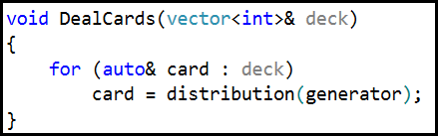
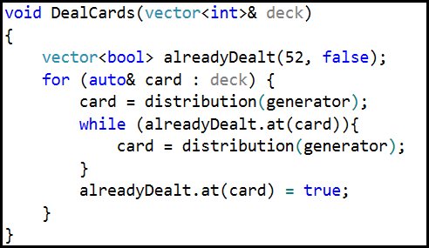
Lab 5 – Slow Card Dealer
Bogus Card Dealer
Slow Card Dealer

Slide 21
Lab 6 – Fast Card Dealer
There is an inherent inefficiency in the naïve algorithm
It takes longer and longer, as more cards are dealt, to randomly pick (i.e. to find) a card that has not yet been dealt
We need to discover an algorithm that, while ensuring every card is dealt only once, doesn't lose time at the end of the deal searching for that one remaining card that has not yet been dealt
The improved algorithm doesn’t need an alreadyDealt helper bool vector and was discovered by a 7th grader!

Slide 22
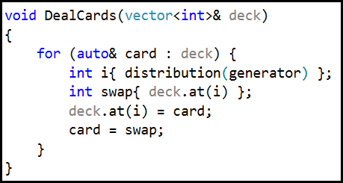
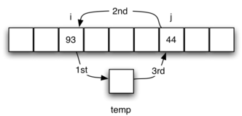
Lab 6 – Fast Card Dealer
No coding required – just run the solution
Consider the revised function DealCards()
Describe in your own words what makes the Fast Dealer approach so much better than the Slow Dealer
Fast Card Dealer

Slide 23
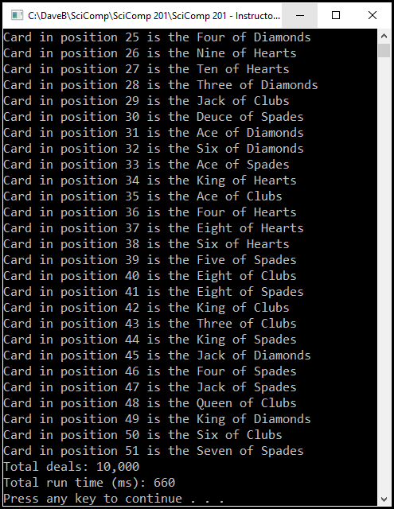
Lab 6 Fast Card Dealer 660 ms 479% faster than Slow Card Dealer !

Slide 24
Slow vs Fast Card Dealer
Fast Card Dealer
Slow Card Dealer

Slide 25
Now you know…
A stochastic process is a random process – though it unfolds in a random sequence each time, in the long run, key statistics start to take shape that we can use to describe the process
The base of the natural logarithm (e) shows up in the most unexpected places throughout mathematics and the sciences
The Birthday Paradox highlights how easily our “common sense” intuition fails when it comes our understanding of the true nature of statistics

Slide 26
Now you know…
How to encode and decode two independent concepts into a single integer using the / and % (modulus) operators
The best algorithms:
Are the ones that leave you scratching your head going “That is so obvious – why didn’t I think of that?”
Are often the shortest algorithms in terms of source code length
Are also normally the fastest algorithms to execute

